Slide 1
MODULE 4
Environmental Management Plan (EMP): Goal and purpose- Importance of EMP- Content of an EMP- Role of environmental monitoring program
Environment Audit: need for audit- audit types and benefits- environmental audit procedure
ISO 14001 standards: Importance, salient features - Stages in implementation- Benefits

Slide 2
Environmental Management Plan (EMP)
EMP is aimed at mitigating the possible adverse impacts of a project and ensuring that the environmental quality is maintained.
Covers all aspects of environmental migratory ac­tion plan including human resources management of the entire project operation starting from con­struction and operation of the project.
Essential element of EIA report.
A document to be prepared as a part of the Environmental Impact Assessment (EIA) report(or it can be an independent document)
Document contains the organizational structure, responsibilities, procedures, and resources to deal with all relevant environmental issues and to achieve effective and long-term compliance in environmental protection.

Slide 3
Intends to outline the actions to be taken to manage the impacts from the Project activities.
An EMP includes a project management plan to remediate and prevent potential impacts determined by a monitoring program.
Designed to ensure appropriate measures are taken to handle significant impact issues that are most likely to arise during the construction and operational phase of a project.
In order to achieve the EMP target, thus, the environmental specifications or recommendations are made.

Slide 4
Objectives of EMP
Overall conservation of environment.
Minimization of waste generation and pollution.
Judicious use of natural resources and water.
Safety, welfare and good health of the work force and populace.
Ensure effective operation of all control measures.
Vigilance against probable disasters and accidents.
Monitoring of cumulative and long-term impacts.
Ensure effective operation of all control measures

Slide 5
EMP include
Conceptualization: preliminary environmental assessment
Planning: detailed studies of environmental impacts and design of safeguards
Execution: implementation of environmental safety measures
Operation: monitoring of effectiveness of built-in safeguards

Slide 6
Scope of EMP
It covers:
Management and mitigation measures;
Institutional arrangements;
Implementation and supervision responsibilities;
Monitoring and evaluation requirements;
Implementation schedule;
Training needs; and Budget.
Includes measures to consider during project implementation and operation; and
Provides actions to be taken to implement these measures

Slide 7
The management plans should be necessarily based on considerations of resource conservation and pollution abatement, some of which are:
Liquid Effluents
Air Pollution
Solid Wastes
Noise and Vibration
Occupational Safety and Health
Prevention, maintenance and operation of Environment Control Systems
House-Keeping
Human Settlements
Transport Systems
Recovery - reuse of waste products
Vegetal Cover
Disaster Planning
Environment Management Cell

Slide 8
Goal of EMP
Develop procedures to implement project’s mitigation measures & monitoring requirements.
Provide auditable commitments to practical and achievable strategies and design standards;
Develop an integrated plan for comprehensive monitoring and control of project impacts, and;
Ensure the community that the environmental management of the project is acceptable

Slide 9
Purpose of EMP
Minimize negative impacts
Enhance positive impacts
Ensuring environmentally sustainable planning, construction and operations management
Reduce problems & delays during project Implementation
Improve overall project quality
Add value to the project

Slide 10
Importance of EMP
An instrument for implementing environmental management commitments, conditions, and requirements of project.
Promotes self-regulation & integration of environmental issues in planning and operations.
Addresses relevant environmental management issues
Can be drafted in a consultative manner.
Incorporates regulatory requirements.
Facilitates environmentally sustainable development and decision-making process.
Able to form the basis for consultation and negotiation of outcomes
Flexible, Comprehensive, Updatable, and A tool for promoting accountability

Slide 11
Contents of an EMP
Brief introduction of project design
Major Findings of EIA/screening
Environmental Impacts Overview
Regulatory/Statutory Requirements
Environmental Management Proposed
Pre-construction
Construction
Operation
implementation Arrangements
institutional Arrangements
Monitoring Mechanism
Reporting System
Environmental Training and Management Budget

Slide 12
ENVIRONMENTAL MONITORING PROGRAM
purpose of monitoring is to identify any changes caused by the project activities. It will also establish whether mitigation measures adopted are sufficient to reduce impact
scope of the proposed monitoring program
Site inspection to assess the current progress of construction works on site.
Monitoring of water quality, discharge from silt traps, air quality and noise levels to assess environmental conditions against work progress and intensity.
Analysis of the monitoring result and formulation and recommendations on suitable measures on areas of non-compliance and/or enhancement of environmental quality.
Monitoring and measurement shall be carried out by trained qualified Technician or accredited laboratory under ISO Guide 25/SAMM 1.
Monitoring and measuring equipment shall be controlled and maintained and a copy of the report shall be handed over to the Employer’s Representative and DOE.

Slide 13
Types of Environmental Monitoring
Performance Monitoring (PM) :the monitoring to ensure that the pollution control systems and other mitigation measures are performing in a good condition to reduce the adverse impacts from the proposed Project at a minimum level. Environmental Officer (EO) or Certified Competent Person shall carry out on-site performance monitoring.
Compliance Monitoring (CM):is being employed in the Project site, in order to assess the overall project compliance and opportunity for optimization and further improvement in environmental management of the Project.
Impact Monitoring (IM) :will be carried out to observe the condition of the Project site. The monitoring will be conducted to verify that the findings of the EIA study on the potential impacts identified during the EIA scoping process are correct, appropriate mitigation and prevention measures are properly implemented and the measures are effective in mitigation the adverse impacts to the environment.

Slide 14
ENVIRONMENTAL AUDIT
Environmental auditing means the systematic, documented, periodic and objective evaluation of how well environmental organization, management and equipment are performing in conserving or preserving the environment.
Environmental auditing is mandatory only in cases stipulated by law.
Aim - to facilitate management control of environmental practices and to enable the company to assess compliance with its policies including meeting regulatory requirements.

Slide 15
According to United States Environmental Protection Agency (USEPA), “Environmental audit shall mean a management tool comprising a systematic, documented periodic and objective evaluation of the performance of the organisation, management system and processes designed to protect the environment with the aim of
facilitating management control of practices which may have an impact on the environment;
assessing compliance with the environmental policy including environmental objectives and targets of the organisation.

Slide 16
The concept of environmental auditing in industrial unit in India was formally introduced in March 1992 with an overall objective
of minimizing consumption of resources and promoting use of clean technologies in industrial production to minimize the generation of wastes.
The audit assesses actual environmental impact, the accuracy of prediction, the effectiveness of environmental impact mitigation and enhancement measures, and the functioning of monitoring mechanisms.
The audit should be undertaken after the project has been operational for some time.

Slide 17
Objectives of EA ( Environmental Audit)
To serve to achieve compliance standards and establish a report with regulatory bodies.
To review the implementation of policies.
To identify the liabilities.
To review the management system.
To identify the needs, strengths, weaknesses.
To assess environmental performance.
To promote environmental awareness.
To improve production safety and health.
To reduce waste.

Slide 18
Need of EA
A sound precaution and a proactive measure in today's heavily regulated environment.
EA has a valuable role to play, encouraging systematic incorporation of environmental perspectives into many aspects of an organisation's overall operation, helping to trigger new awareness and new priorities in policies and practices.
EA is needed for
Assessing compliance with relevant statutory and internal requirements
Facilitating management control of environmental practices
Promoting good environmental management
Maintaining credibility with the public

Slide 19
Raising staff awareness and enforcing commitment to departmental environmental policy
Exploring improvement opportunities
Establishing the performance baseline for developing an Environmental Management System (EMS)

Slide 20
Types of environmental audits
Environmental compliance audit – evaluates a company’s environmental performance and environmental responsibility practices, whether the company has complied with legal requirements and other requirements such as ISO 14001. the most comprehensive and, perhaps, the most expensive.
Environmental management audit – verifies whether the company has met the environmental objectives, policies, and performance set by management.
Functional environmental audit – focuses on one element or impact of a particular activity, such as wastewater management audits, materials, and air quality monitoring.

Slide 21
Environmental Audit Procedures
An environmental audit is typically undertaken in three phases:
Pre-audit
On-site audit
Post-audit
Each of these phases comprises a number of clearly defined Objectives, with each objective to be achieved through specific Actions, and these actions yielding results in the form of outputs at the end of each phase.

Slide 22
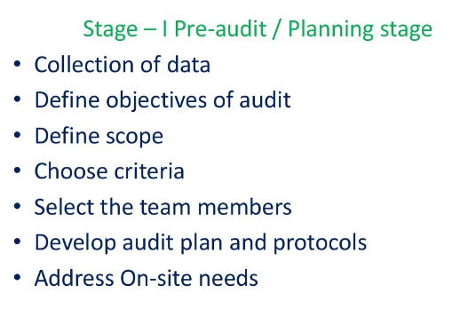

Slide 23
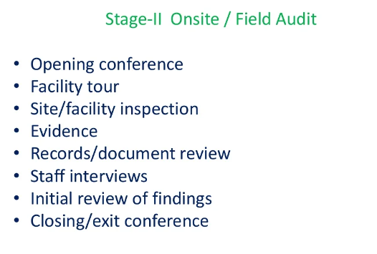

Slide 24
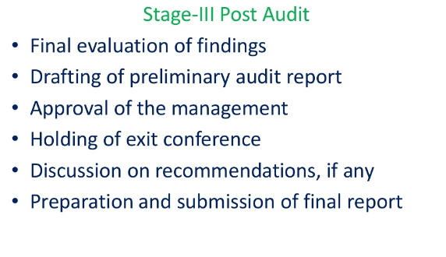

Slide 25
The 5 Stages of Environmental Audit – The steps of environmental audit
Step 1: Schedule the Audit
starts with an organization’s Environmental Management Representative (EMR) scheduling audits .Environmental managers can determine how frequently the audit should be performed through consultation with relevant Government Agencies and/or a review of specific project requirements.

Slide 26
Step 2: Plan the Audit
is for the EMR to establish and document the Area/Contractor to be audited, the reason and scope of the audit, and the contact names for the Area/Contractor. The EMR must also appoint and notify a qualified Lead Auditor or audit member if required. If warranted, the EMR can appoint themselves as the Lead Auditor.
Step 3: Conduct the Audit
All relevant personnel in the Audit Team should meet to discuss the scope of the audit, the proposed audit agenda, the audit objectives, any project personnel that need to be contacted or interviewed, and a tentative time to hold the exit meeting.

Slide 27
Step 4: Develop an Audit Report/Action Plan
audit team needs to prepare a report based on all the objective evidence that was collected during the audit. This report must be forwarded to the Company official within 2 days of completion of the audit. The final report must be distributed to the Auditor, Company official, Independent Reviewer and Environmental Auditor, the State, and all other relevant personnel.
Step 5: Audit Follow-Up
The EMR will follow up on the closing out of any remaining contract items by the Company official. It can be done separately and can even be done whenever the next relevant audit takes place, depending on how significant the finding is.

Slide 28
ISO 14001
ISO 14001 is a set of standards put forward by the International Organization for Standardization (ISO).
Standard for an environmental management system
Defines the requirements for controlling and improving the organization’s environmental impact.
First implemented in 1996.
Recommends controls for those processes that have an environmental impact.
E.g. Use of environment resources, environmental waste management & energy consumption.

Slide 29
Purpose of ISO 14001
The main purpose -is to define the requirements for the EMS and provides guidance for its implementation.
The standard gives a structured activity for making environmental improvements in the organization.

Slide 30
Importance of ISO 14001
Corporate and social responsibility
Supporting environmental change
Continuous improvement

Slide 31
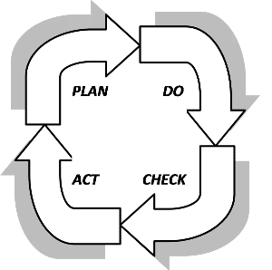
Plan-Do-Check-Act Cycle
Plan-Do-Check-Act( PDCA), is a cycle for improvement
originated and made popular by two of the fathers of modern quality control, Walter Shewhart and Edward Deming.
The cycle is used when implementing a change in order to improve a process

Slide 32
Plan-Do-Check-Act Cycle in ISO 14001
Plan. Starting with understanding the context of your organization and what the needs and expectations.
Then determine what EMS scope is and define EMS
Identify leadership commitment ,set your environmental policy to guide your EMS and identify the roles, responsibilities and authorities required
address the risks and opportunities within your EMS including how to interact with the environment and your legal compliance obligations as well as setting and planning to achieve environmental objectives for improvement
The final stage involves support processes such as setting processes for assigning resources ,identifying competence requirements and what awareness is required within your EMS.
The process for internal and external communication and creating and controlling documented information for the EMS complete these support processes.

Slide 33
Do. what processes are important to establish and maintain in order to have a strong and successful EMS.
The starting point is in establishing the operational controls needed to ensure that the processes of the organization can function in such a way that negative effects on the environment are controlled.
The final step is to have the plans in place for emergency preparedness and response ,if anything actually go wrong.

Slide 34
Check. performance evaluation
The methods :monitoring, measurement, analysis and evaluation which applies to the key characteristics of the organization that can have significant impact on the environment as well as an evaluation of compliance.
Second method:internal audits which is a systematic way to review the processes of the EMS to validate that they are meeting the planned arrangements that are set out for them.
The final section :involves having management of the organization review the information collected in the checking processes; this is called management review

Slide 35
Act. dealing with nonconformity and corrective action in order to fix problems found during performance evaluation. This activity is done in order to react to the information gathered and make any necessary adjustment to the plans for the EMS.
If a target has been met, then a new target can be chosen. If there are problems reaching a target, then resources for the program can be reviewed and adjustments made. These activities are completed with requirements for continual improvement as a way to ensure the EMS improves over time.
This Act phase allows the plans to be modified so that the cycle of improvement, Plan-Do-Check-Act, can start again.

Slide 36
ISO 14001 implementation steps
Obtain management support
Identify legal requirements
Define EMS scope
Define EMS procedures and processes
Implement EMS procedures and processes
Perform training and awareness
Operate the EMS; measure and keep records
Perform internal audits
Perform management review
Implement corrective actions
Certification audit

Slide 37
Benefits of using ISO 14001
Improve resource efficiency
Reduce waste
Drive down costs
Provide assurance that environmental impact is being measured
Gain competitive advantage in supply chain design
Increase new business opportunities
Meet legal obligations
Increase stakeholder and customer trust
Improve overall environmental impact
Manage environmental obligations with consistency

Slide 38
ISO 14001 structure
is split into ten sections. The first three are introductory, with the last seven containing the requirements for the environmental management system. Here is what the seven main sections are about:
Section 4: Context of the organization – about requirements for understanding your organization in order to implement an EMS. It includes the requirements for identifying internal and external issues, identifying interested parties and their expectations, defining the scope of the EMS and identifying the processes required for the EMS.
Section 5: Leadership – cover the need for top management to be instrumental in the implementation of the EMS.
Top management needs to demonstrate commitment to the EMS by ensuring environmental commitment, defining and communicating the environmental policy and assigning roles and responsibilities throughout the organization.

Slide 39
Section 6: Planning – Top management must also plan for the ongoing function of the EMS. Risks and opportunities of the EMS in the organization need to be assessed, and environmental objectives for improvement need to be identified and plans made to accomplish these objectives. Additionally, it is necessary for the organization to assess all the ways in which the organizational processes interact and affect the environment as well as the legal and other commitments that are required for the organization.
Section 7: Support – The support section deals with management of all resources for the EMS, and also includes requirements around competence, awareness, communication and controlling documented information (the documents and records required for your processes).
Section 8: Operation – The operation requirements deal with all aspects of the environmental controls needed by the organizational processes, as well as the need to identify potential emergency situations and plan responses so that you are prepared to respond should an emergency occur.

Slide 40
Section 9: Performance evaluation – This section includes the requirements needed to make sure that you can monitor whether your EMS is functioning well. It includes monitoring and measuring your processes, assessing environmental compliance, internal audits, and ongoing management review of the EMS.
Section 10: Improvement – This last section includes the requirements needed to make your EMS better over time. This includes the need to assess process nonconformity and taking corrective actions for processes.
These sections are based on a Plan-Do-Check-Act cycle, which uses these elements to implement change within the processes of the organization in order to drive and maintain improvements within the processes.

Slide 41
